Slide 1

Setting Day Ticket Price for Big Mountain Resort
Springboard Guided Capstone Project
Rachel Chiang
January 2023

Slide 2
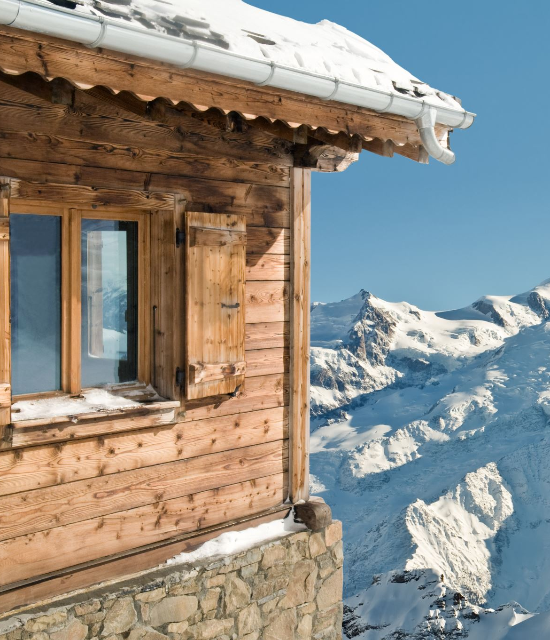
Big Mountain Resort
New chairlift increased operating costs by $1.54M
Covering the new costs
Ticket pricing
Adjusting facilities themselves (adding, removing, or changing features)
Notes:
Background information about Big Mountain Resort
Ski resort in Montana near Glacier NP and Flathead NF
350,000 skiers and snowboarders per year
New chairlift to increase visitor distribution around the park, which added $1.54M to operating costs
Resort wants to know how to cover this increase in cost
Typically, Big Mountain Resort simply prices their tickets to be above the average market price, but this may not be sensitive to the actual value of its facilities
Resort is also considering adjusting the facilities themselves in order to cut costs or increase revenue, but this faces the same problem—that the resort does not know how to evaluate their tickets
Problem Statement
- How can the resort capitalize on its sport-accommodating facilities to increase its ticket price to at least cover the $1.54M increase in operating costs within one season?

Slide 3
How should we cover the increased operating costs?
Learn what people value in sport-accommodating facilities
Look at relationship between entry cost and resort features
Change in pricing strategy or further changing facilities must cover at least $1.54M over the next season
Notes:
(Solutions and why)
Examine many resorts ticket pricing with their sport-accommodating facilities, such as chairlifts and runs, to understand what sorts of facilities people may find value in
By doing so, we can more accurately price our ticket, or we can make a more guided decision in changing the resort’s current facilities
Without knowing what people find appealing in a resort, how can we know what to change?
Since the goal is to cover the $1,540,000 increase in operating cost, assuming we have 350,000 visitors again, with each visitor buying 5 tickets per visit, each ticket price must be increased by at least 88 cents each

Slide 4
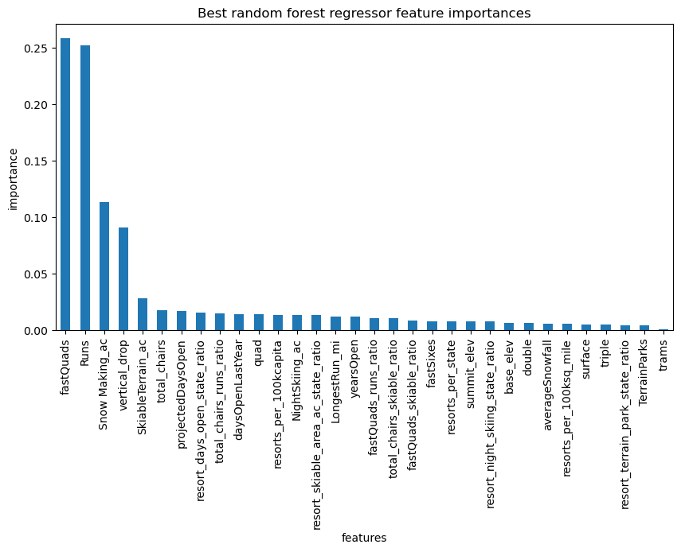
Key Findings
Favored Features
Fast Quads
Runs
Snowmaking cover
Vertical drop
The true ticket price: $95.87, up from the current $81
Given four scenarios, two may be promising:
Close one of the least used runs (-$0/ticket)
Increase the vertical drop by adding a run to a point 150 feet further down and install one more chairlift (+$1.99/ticket)
Notes:
According to our findings, the model suggested that the resort’s true ticket price should be increased to $95.87 from the current price of $81, which more than exceeds covering the new chairlift’s operating cost
Important note: the model is dependent on other resorts’ data, so the assumption is that other resorts are not terribly or too widely overpricing or underpricing their own facilities
Our random forest model found the number of fast quads, the number of runs, the snowmaking coverage, and the vertical drop to be the most important features—all of which, Big Mountain Resort ranks highly on when compared to other resorts.
Given four scenarios that the resort was considering implementing, two may be promising and worth further consideration: (1) close one of the least used runs and (2) increase the vertical drop by adding a run to a point 150 feet further down and install one more chairlift
Closing just one run would not impact the ticket price
Increasing the vertical drop by adding a run and installing a chairlift could increase the ticket price by $1.99
If both options want to be considered at the same time, I recommend further testing

Slide 5
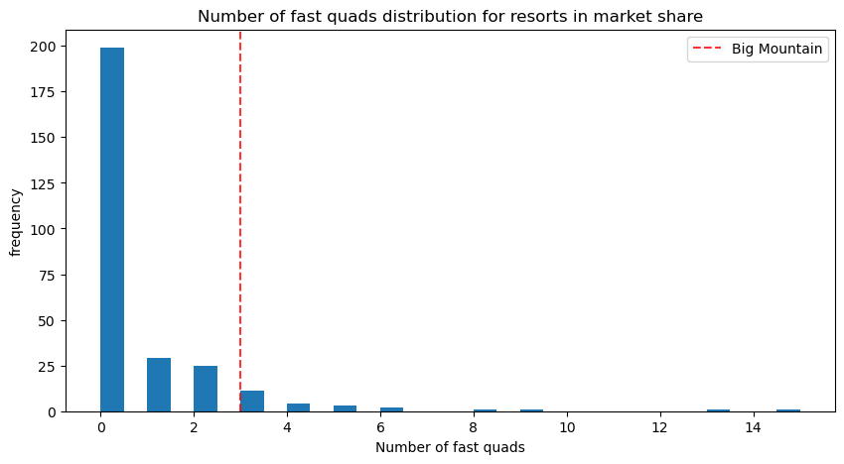
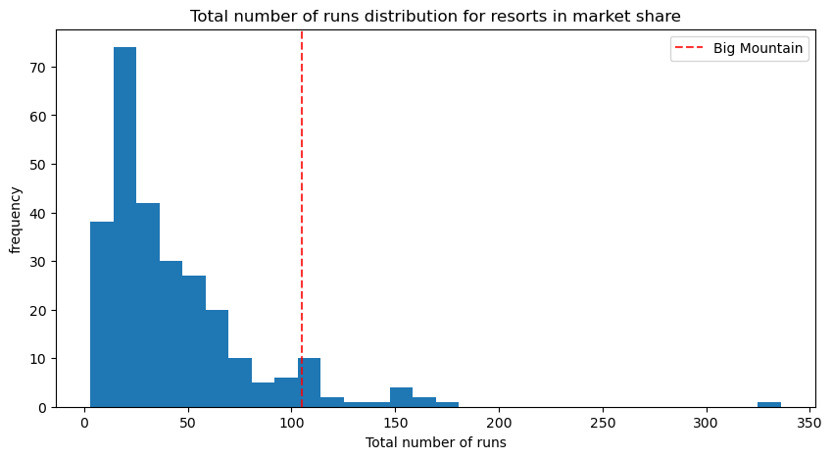
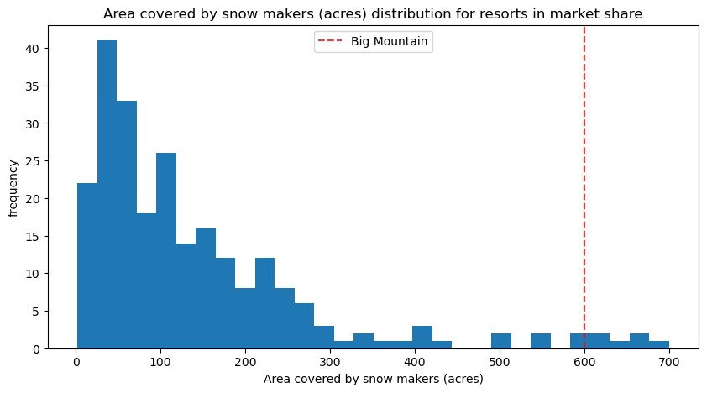
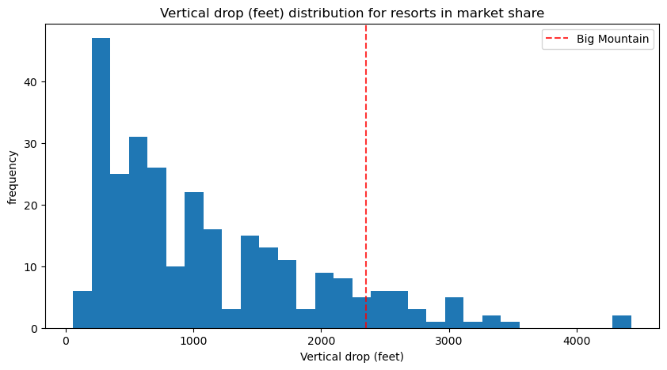
Big Mountain’s Big Four
Histograms illustrating how Big Mountain Resort compares with other resorts in the market share for the model’s four most important features:
Fast Quads
Total Runs
Snowmaking Area
Vertical Drop
Notes:
To reiterate, our random forest model found these four features to be strongly positively correlated with the ticket price: the number of fast quads, the total number of runs, the area covered by snowmakers, and the vertical drop.
In each of these categories, Big Mountain Resort consistently ranks above average, which explains why the model valued Big Mountain Resort to be somewhat high at $95.87. This still isn’t the most expensive ticket, but it does land the ticket more squarely in the highest value quartile.
Increasing the ticket cost to $95.87 would more than cover the required increase in ticket price for the new chairlift, which if we recall, needed only an 88-cent increase per ticket.

Slide 6
Big Mountain’s Four Scenarios
Option 1: Permanently close down 1-10 of the least used runs
Option 2: Increase the vertical drop by adding a run to a point 150 feet further down and install another chairlift
Option 3: The same as Option 2 but also add 2 acres of snowmaking cover
Option 4: Increase the longest run by 0.2 miles and add 4 acres of snowmaking cover
Notes:
The resort was also considering changing the facilities themselves in order to cut operating costs or to further increase revenue. The four options were as follows:
Permanently close 1 to 10 of the least used runs
Increase the vertical drop by adding a run to a point 150 feet further down and install another chairlift
Do option 2 but also add 2 acres of snowmaking cover
Increase the longest run by 0.2 miles and add 4 acres of snowmaking cover

Slide 7
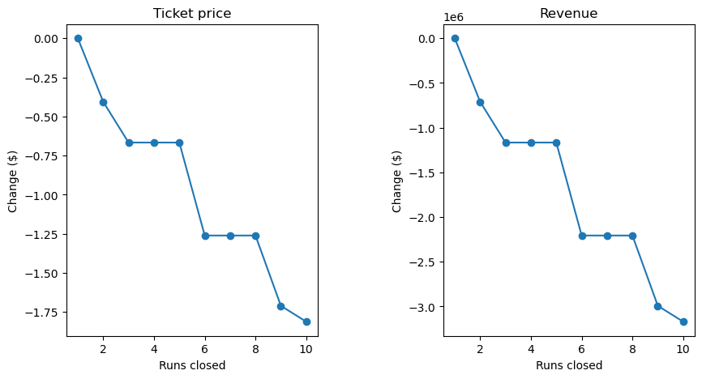
Scenario 1
Closing runs:
1 run makes no difference
2 or 3 runs decreases the ticket price
6 runs brings a sharp decrease in ticket price
Consideration: close the runs in batches
Question: How does closing runs affect operating costs?
Notes:
Scenario 1: Close 1 to 10 of the least used runs
The model found that closing just one run did not change the ticket price
However, additional closures of runs caused a decline in ticket price
Interestingly, if the resort wished to close more runs, they could consider closing them in groups of 3 to 5 or 6 to 8 without affecting the ticket price within these batches.
Regardless of what we go with, it is important to ask how closing runs affects the operating costs, which we weren’t given data on. Our initial problem is to cover the $1.54M increase in operating costs, so this option must somehow address this. Closing runs will likely decrease operating costs, but the question is, “by how much?”
We cannot evaluate closing more than one run without knowing how much we gain from doing so, but it should be safe enough to say that closing just one run should be fine.

Slide 8
Scenarios 2 & 3
Scenario 2
Scenario 3
+150 ft Vertical Drop
+1 Run
+1 Chairlift
+150 ft Vertical Drop
+1 Run
+1 Chairlift
+2 acres Snowmaking Cover
Increases Ticket Price by $1.99
Expected Increase over Season is $3,474,638
Question: How do the additional features affect operating costs?
Notes:
Scenario 2 and 3 both involve increasing the vertical drop by adding a run to a point 150 feet further down and installing another chairlift, but Scenario 3 would also add 2 acres of snowmaking cover.
The model predicted the same change in ticket price given either of the scenarios. Both would increase the ticket price by $1.99, meaning that overall, it would be almost a $3.5M increase.
Since the scenarios resulted in the same change in price, it’s probably not worth it to add another 2 acres of snowmaking cover.
We come to a similar question as we did when evaluating option 1 though. How do the additional features affect operating costs?

Slide 9
Scenario 4
Increase the longest run by 0.2 miles and add 4 acres of snowmaking cover
No change in ticket price
Consideration: What if the model was different?
Notes:
The fourth scenario was to increase the longest run by 0.2 miles and add 4 acres of snowmaking cover.
The model predicted no change in ticket price.
However, this model does not consider the longest run or additional snowmaking cover as important as other features, and a different model, such as the linear model that we were considering, could find this scenario more promising.
On the bright side, adding these things doesn’t decrease our ticket price, but we again are faced with a question of how much it would cost to make these changes. Is it worth it to add to these features?

Slide 10
Conclusion
Ticket price → $95.37?
Options 1 (close a run) and 2 (increase vertical drop, add a run, add a chairlift)
Four most important features:
Fast Quads
Runs
Snowmaking Cover
Vertical Drop
Other useful information that was missing:
Data on number of tickets sold
Number of visitors for other resorts
Operating costs of resorts and of the different scenarios
Notes:
So, how can the resort capitalize on its sport-accommodating facilities to increase its ticket price to at least cover the $1.54M increase in operating costs within one season?
We have found that we could simply increase the ticket price, since our resort has many features (these four) that seem to be valuable based on the data from competing ski resorts.
A new ticket price of $95.37 easily surpasses the increase in operating costs.
Otherwise, or additionally, we could consider changing certain features.
We could close a run without it impacting ticket price. Hopefully, this helps decrease operating costs, resulting in a net benefit
Or we could increase the vertical drop, add a run, and add a chairlift. This would increase the value of our resort, but we would also need to weigh the change in operating costs given these new features.
Evidently, there is some information that we are missing to decide for certain. We did not know how many tickets sell or how many visitors there are at other resorts, and we don’t know the operating costs of different scenarios.
We had to assume that the other resorts fairly price their tickets according to their features, but with some more information, we could get further insights on what is truly valuable to the customers.

